Slide 1
Professional Software Development
Lecture 10

Slide 2
Software Process
A software process is a road map that helps you create a software.
It is the way we produce software and it provides stability and control.
Each process defines certain deliverables known as the work products. These include programs, documents, and data produced as a consequence of the software engineering activities. A timely, high quality result.
Example: SDLC

Slide 3
Software Development Life Cycle
Software Development Life Cycle (SDLC) is a process used by the software industry to design, develop and test high quality software.
The SDLC aims to produce a high-quality software that meets or exceeds customer expectations, reaches completion within times and cost estimates.

Slide 4
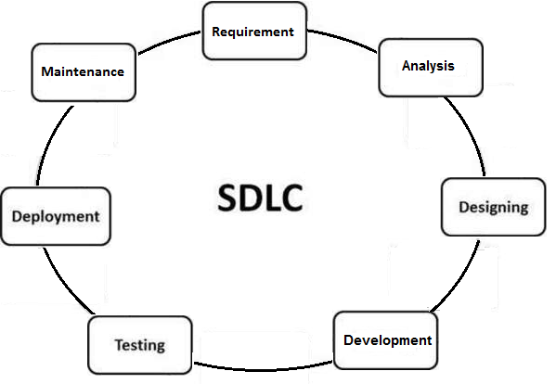
Software Development Life Cycle

Slide 5
Software Development Life Cycle
Requirement Gathering: In this phase requirement/demands for new software are collected from Stakeholder. This could be done in the form of Interview, meetings, document review, existing system review etc. All the information is documented.
These are general questions that get answered during a requirements gathering phase.
Who is going to use the system?
How will they use the system?
What data should be input into the system?
What data should be output by the system?
Role: Business Analyst

Slide 6
Software Development Life Cycle
2. Requirement Analysis:
In this Phase requirements are analyzed for their validity and the possibility of incorporating the requirements in the system to be development is also studied.
Software Requirement Specification (SRS) document is created which serves the purpose of guideline for the next phase of the model like Designing, Development and Testing.
Role: Business Analyst

Slide 7
Software Development Life Cycle
3) Design: In this phase the system and software design is prepared from the requirement specifications which were studied in the first phase. System Design helps in specifying hardware and system requirements and also helps in defining overall system architecture. The system design document specifications (DDS) serve as input for the next phase of the model.
Example: Front end → C++
Backend → Oracle database
→ how many table?
→ how to store and fetch data?
Role: System Architect

Slide 8
Software Development Life Cycle
4) Development/ Coding: In this stage of SDLC the actual development starts and the product is built. The programming code is generated as per DDS during this stage. If the design is performed in a detailed and organized manner, code generation can be accomplished without much hassle.
Developers must follow the coding guidelines defined by their organization and programming tools like compilers, interpreters, debuggers, etc. are used to generate the code. Different high level programming languages such as C, C++, Pascal, Java and PHP are used for coding. The programming language is chosen with respect to the type of software being developed.
Role: Developer

Slide 9
Software Development Life Cycle
5) Testing: In this Phase of SDLC ready software is tested against the requirements (SRS) to make sure that the product is actually solving the needs addressed and gathered during the requirements phase. During this phase all types of functional testing like unit testing, integration testing, system testing, acceptance testing are done as well as non-functional testing are also done.
Role: Tester

Slide 10
Software Development Life Cycle
6) Deployment: In this Phase of SDLC product/software is delivered/handover to the customer for their use.
Role: No Specific Role (all team involved)
7) Maintenance: Once when the customers starts using the developed system then the actual problems comes up and needs to be solved from time to time. This process where the care is taken for the developed product is known as maintenance.
Role: Customer Service/ Technical Support Team

Slide 11
Software Process Models

Slide 12
Waterfall
Iterative
Incremental
Prototype
Spiral
Agile

Slide 13
Waterfall Model
The Waterfall Model was the first Process Model to be introduced. It is also referred to as a linear-sequential life cycle model. It is very simple to understand and use. In a waterfall model, each phase must be completed before the next phase can begin and there is no overlapping in the phases.

Slide 14
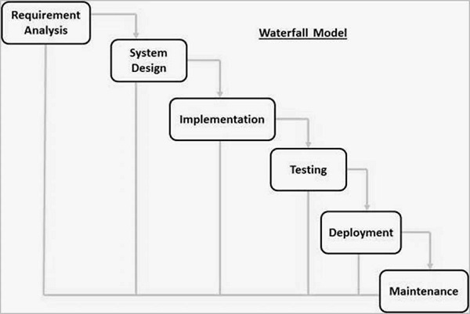
Waterfall Model

Slide 15
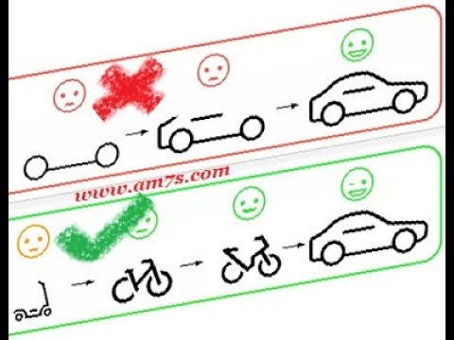
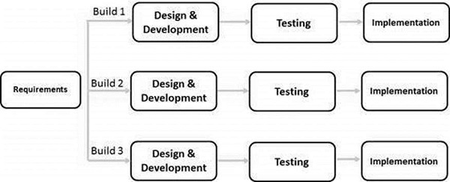
Iterative Model
In the Iterative model, iterative process starts with a simple implementation of a small set of the software requirements and iteratively enhances the evolving versions until the complete system is implemented and ready to be deployed.

Slide 16
Incremental Model
Incremental Model is a process of software development where requirements are broken down into multiple standalone modules of software development cycle.

Slide 17
Prototype Model
The prototyping model is a systems development method in which a prototype is built, tested and then reworked as necessary until an acceptable outcome is achieved from which the complete system or product can be developed.

Slide 18
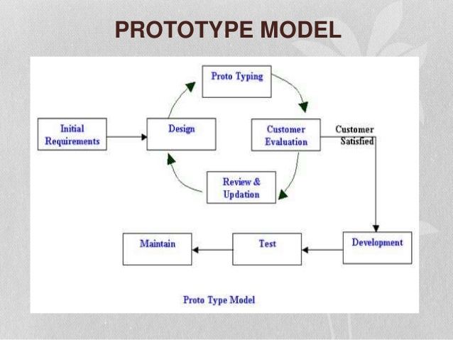

Slide 19
Spiral Model
The spiral model combines the idea of iterative development with the systematic, controlled aspects of the waterfall model. This Spiral model is a combination of iterative development process model and sequential linear development model i.e. the waterfall model with a very high emphasis on risk analysis. It allows incremental releases of the product or incremental refinement through each iteration around the spiral.

Slide 20
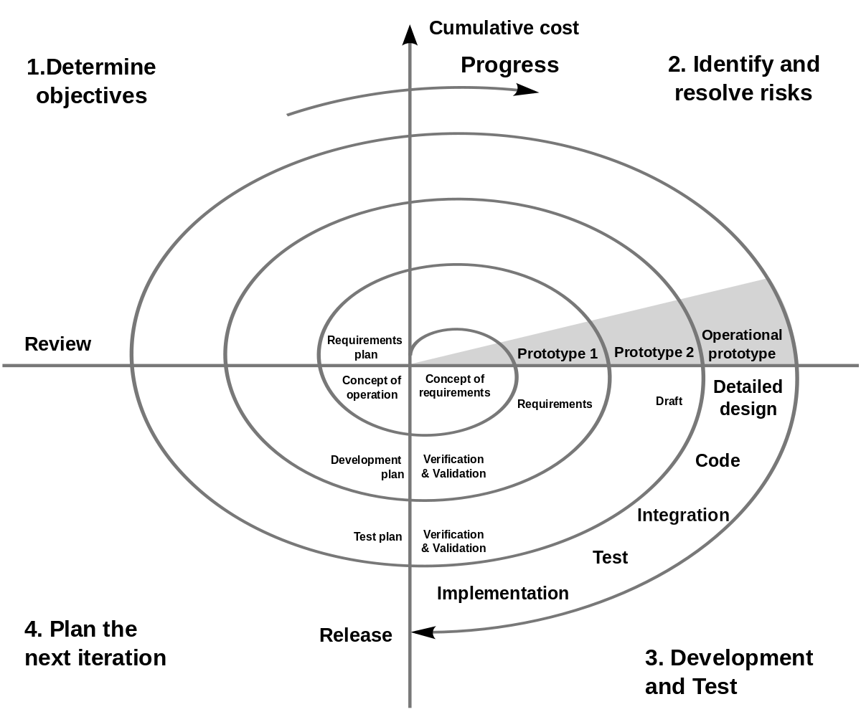
Spiral Model

Slide 21
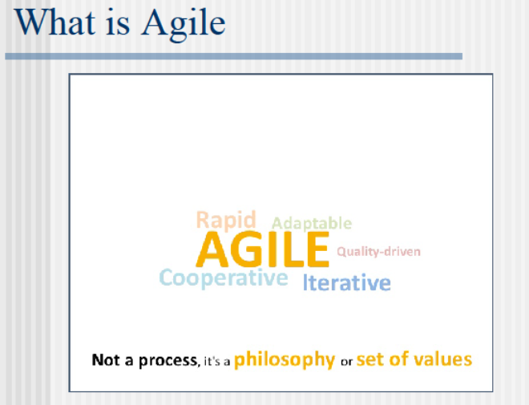

Slide 22
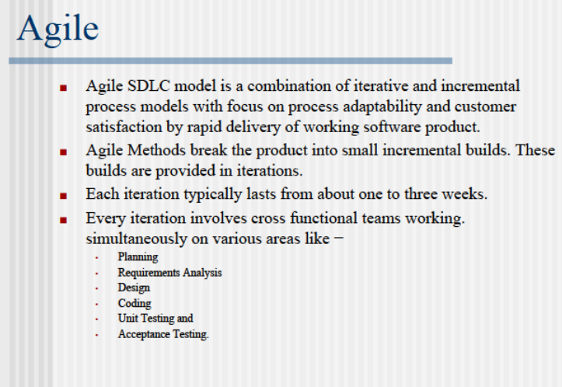

Slide 23
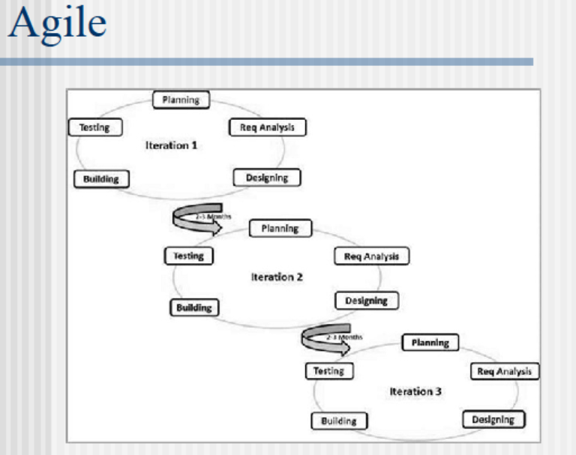

Slide 24
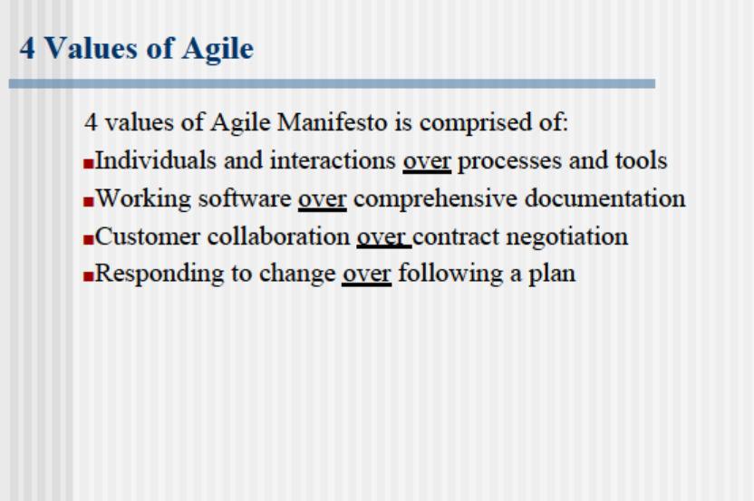

Slide 25
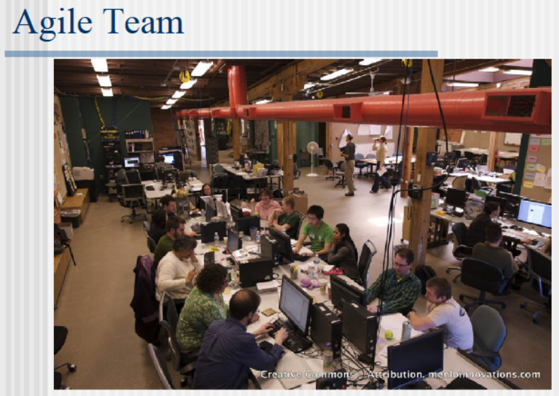

Slide 26
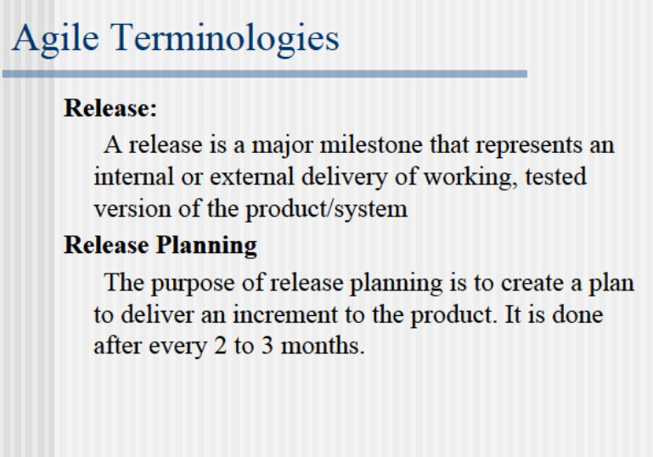

Slide 27
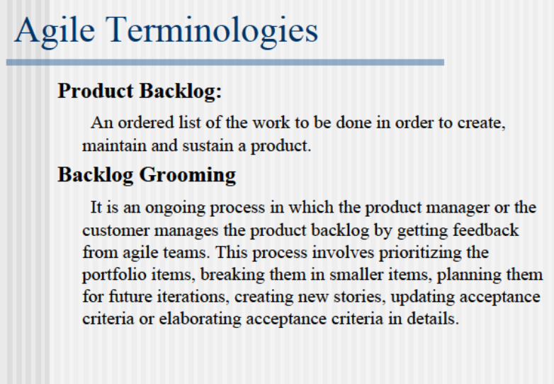

Slide 28
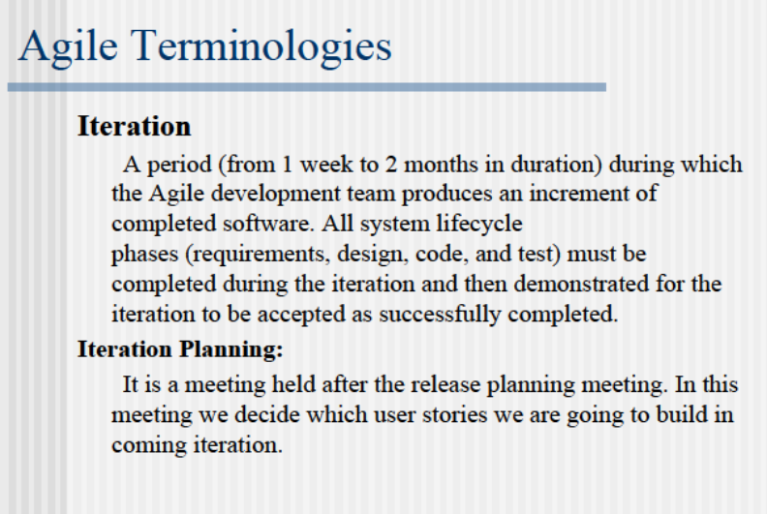

Slide 29
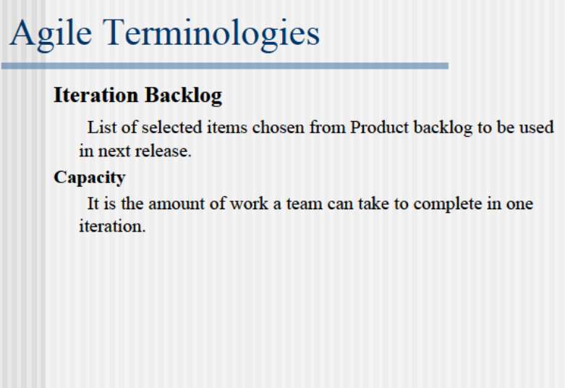

Slide 30
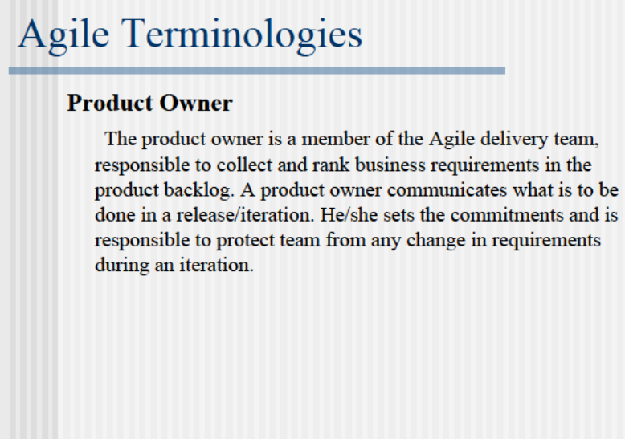

Slide 31
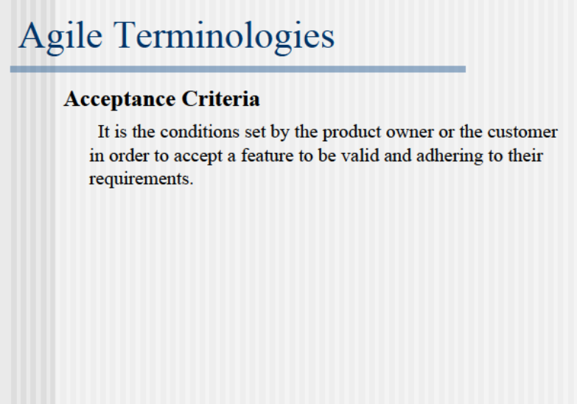

Slide 32
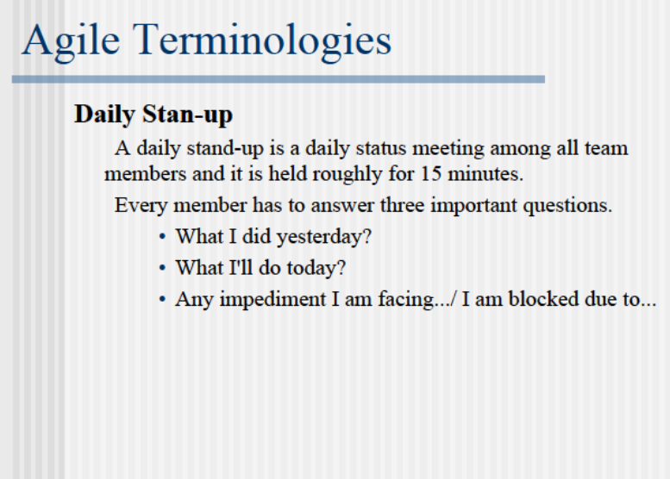

Slide 33
